Slide 1

Understand patient experiences with brief motivational interventions for substance use disorders (SUD)
By: Katy Orleck

Slide 2
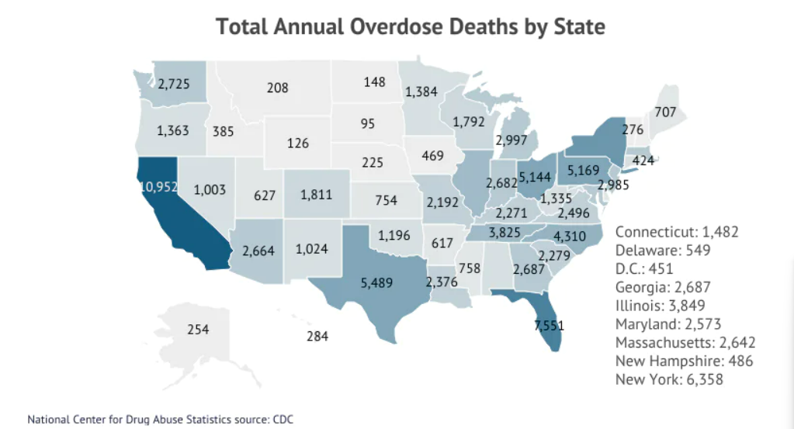
Background
In 2023, Ohio reported 4,745 overdose deaths
Relapse rates: 40-60% of individuals experience at least one relapse during recovery
(SAMHSA, 2025)
(Centers for Disease Control and Prevention (CDC), 2022; Addiction Group, 2025)

Slide 3
Brief Motivational Intervention Survey
Aimed at obtaining patient feedback on the brief motivational interventions provided by occupational therapy inpatient services
Goal is to gather insights from patients on how to improve BMI-based strategies to enhance engagement, motivation, and support long-term recovery

Slide 4
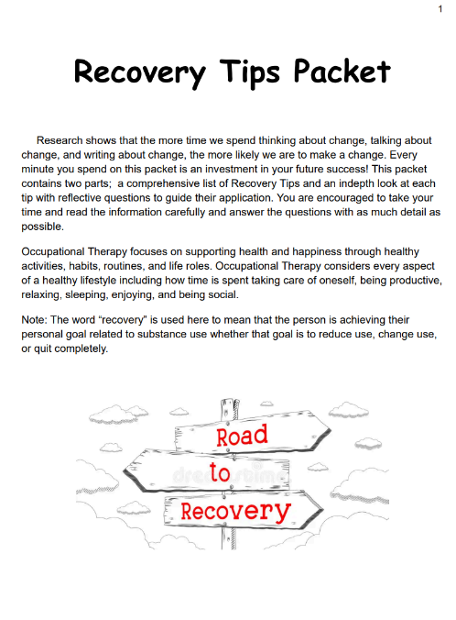
Interventions
Recovery Tips Packet
Activity Card Sort
Goal Setting (Action Plan for substance change)
Coping Skills & Replacement Behaviors
Handout of Podcasts and Apps

Slide 5
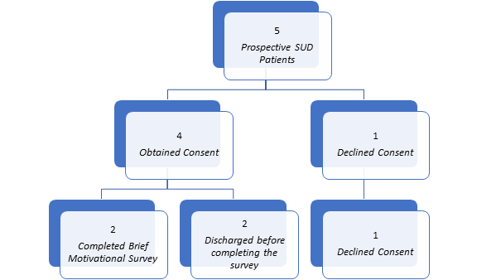
Methodology
Figure 1.1. Prospective SUD patient enrollment (n=5). This flowchart illustrates prospective SUD patients from referral to project completion.

Slide 6
Results
Responded strongly agree on four out of five questions on the Likert Scale
Common Themes:
  Recovery is hard when life becomes difficult
  Approaching recovery by taking baby steps
  Different resources available

Slide 7
Discussion and Implications
Supports long-term recovery rates by focusing on coping skills, replacement behaviors, and environmental and social supports

Slide 8
References
Current Addiction Statistics: 2025 Data on Substance Abuse & Trends. Addiction Group. (2025). https://www.addictiongroup.org/resources/addiction-statistics/
Drug overdose mortality. (2022). Centers for Disease Control and Prevention. https://www.cdc.gov/nchs/state-stats/deaths/drug-overdose.html
June 18, 2024, Ohio Legislative Service Commission Office of Research. (n.d.-a.). https://www.legislature.ohio.gov/download?key=23094
Logan, H. (n.d.). Motivational Interviewing: MI Center for Change. Motivational Interviewing-MI Center for Change. https://www.micenterforchange.com/
Prevention of Substance Use. Substance Abuse and Mental Health Services Administration (SAMHSA). (2025). https://www.smhsa.gov/substance-use/prevention/substance-use-disorders#overview
What is a Substance Use Disorder (SUD)? American Addiction Centers. (2024). https://americanaddictioncenters.org/rehab-guide/substance-use-disorder

