Slide 1
Three Minute Capstone
By: Katy Orleck
Notes:
Hi. My name is Katy Orleck. I will give you an overview of my Capstone project.

Slide 2
Interests
01
02
03
Mental Health
Advocacy
Emerging Practice Areas
Notes:
When proposing a Capstone project I thought of where my interests lie which is in mental health, advocacy and emerging practice areas of OT.

Slide 3
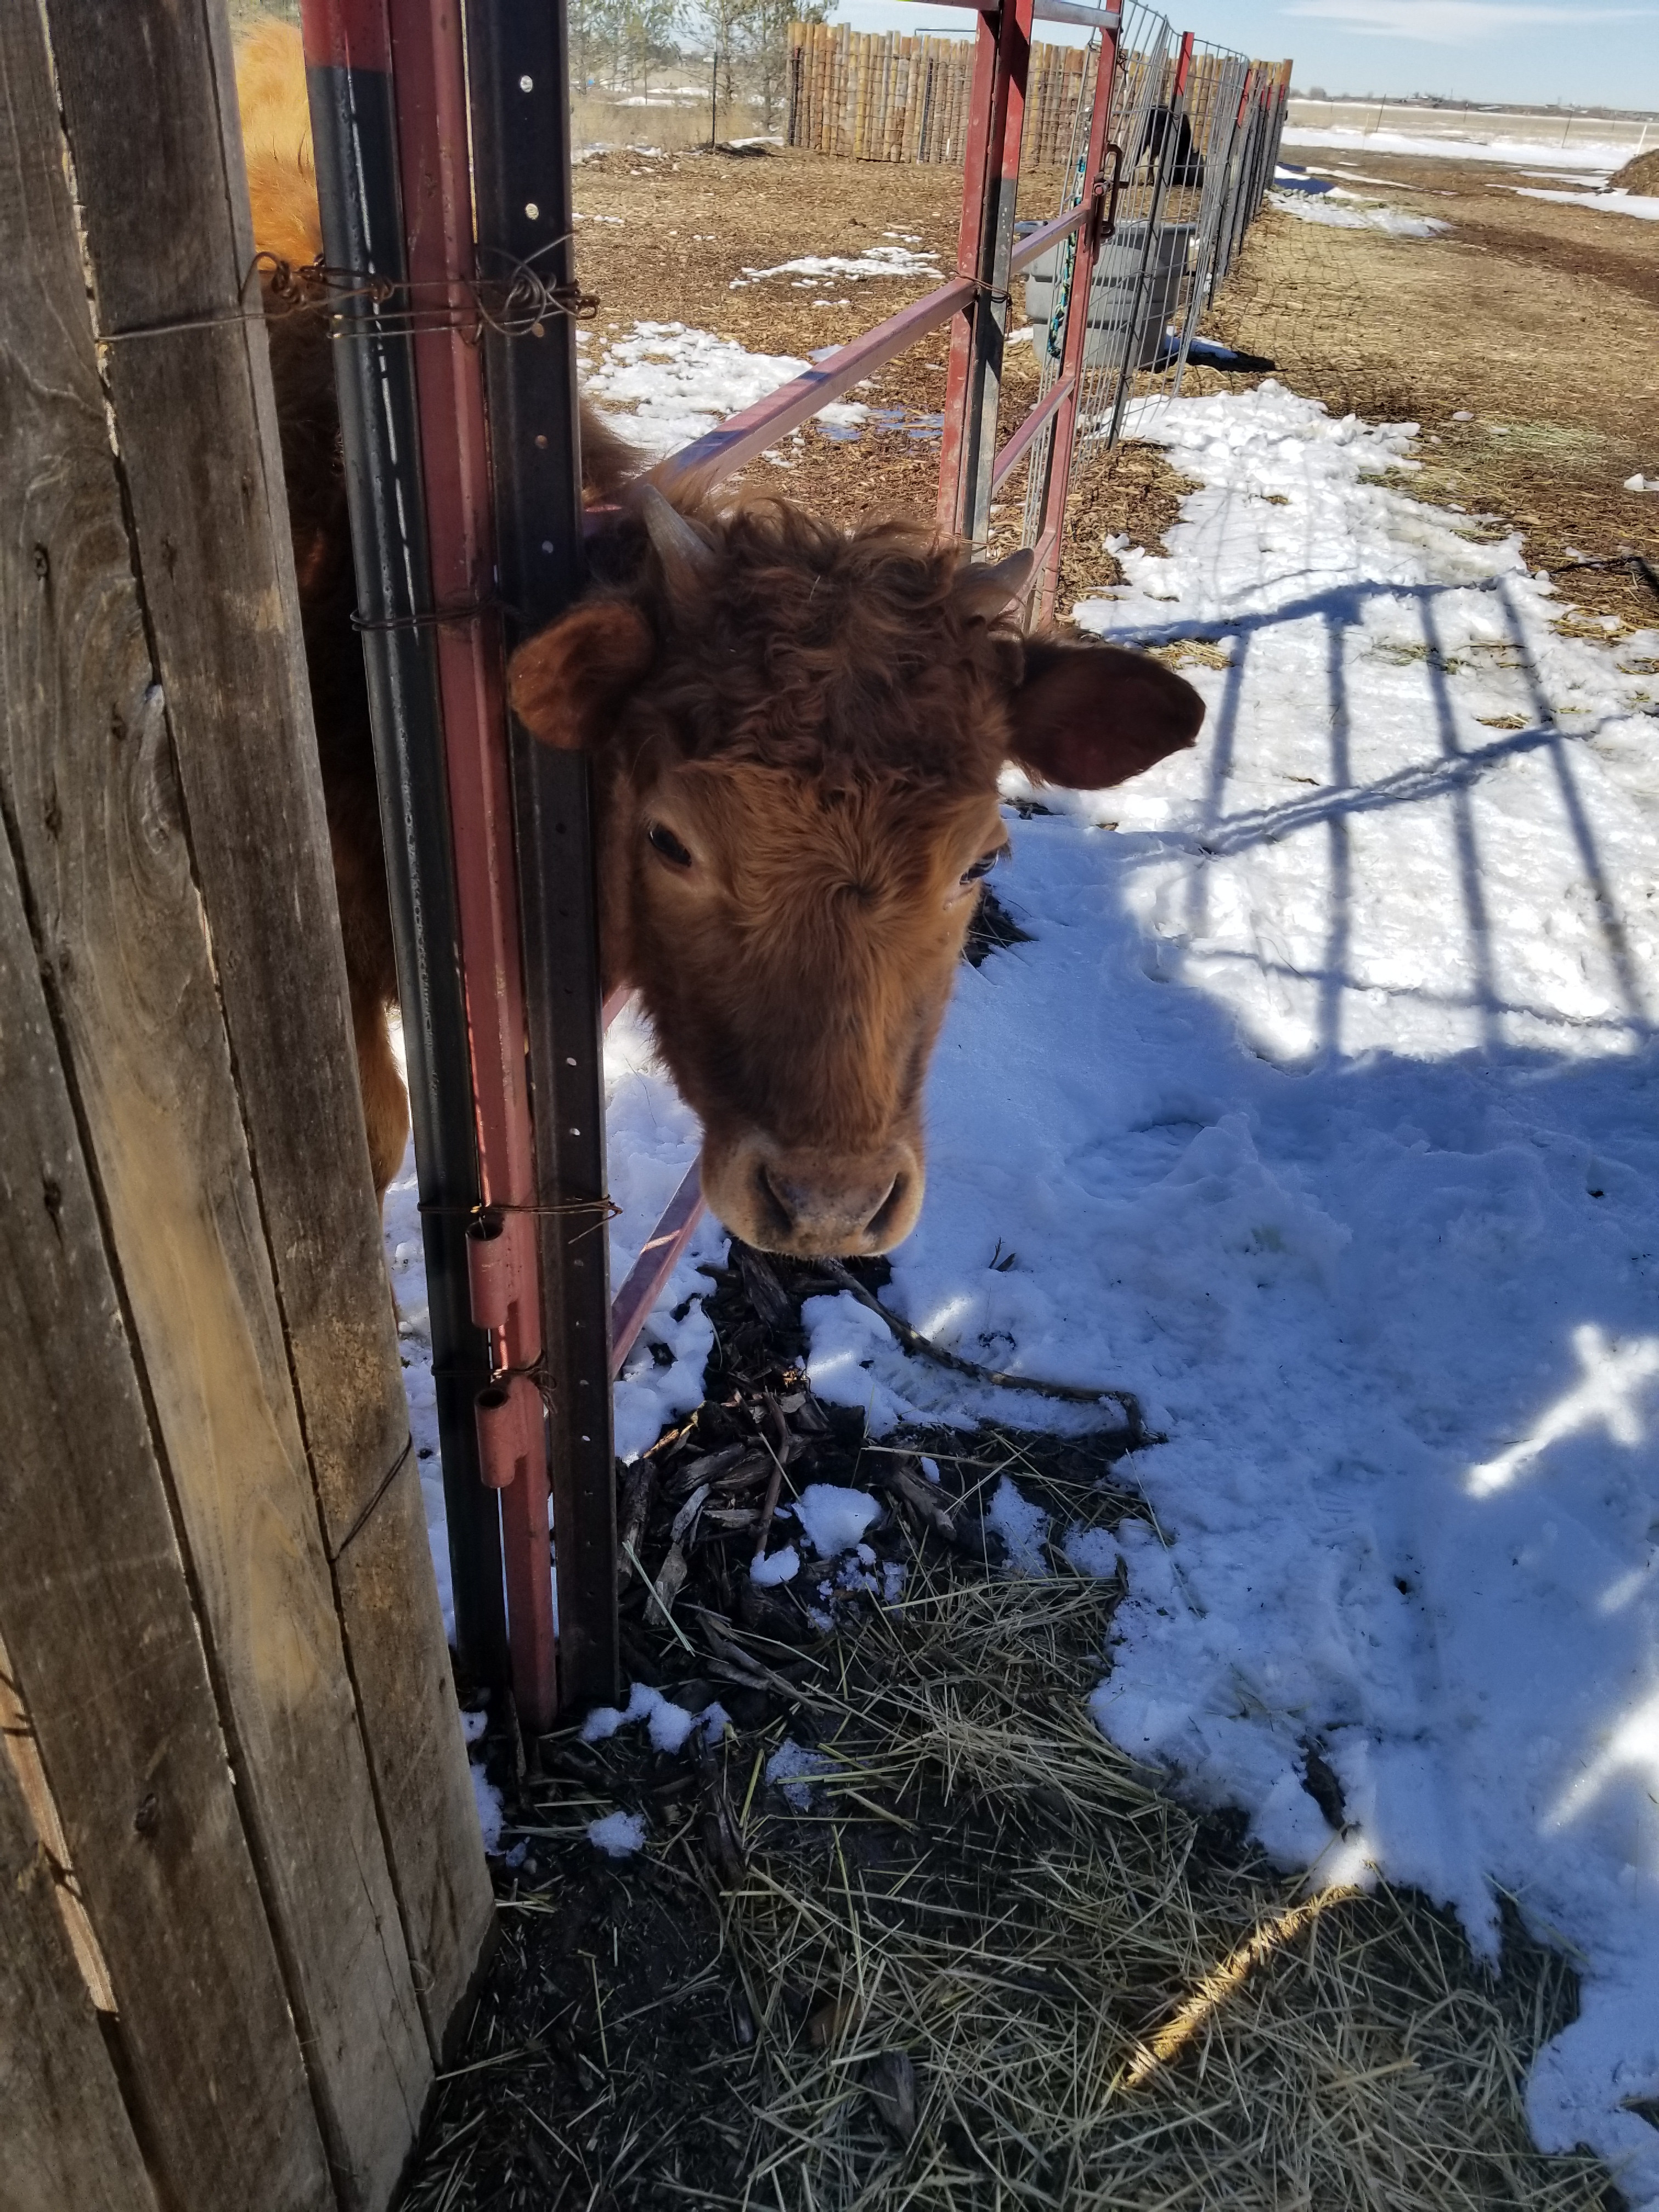
Personal Background
First-hand experience working with males experiencing addiction
(Taken during workforce program)
Notes:
In my past experience, I have worked with males experiencing addiction in a workforce program. Through this, I heard personal accounts of the individual’s life experiences and how healthcare positively and negatively impacted their recovery journey. I then became passionate about advocating for their rights which stemmed into the creation of my capstone idea.

Slide 4


Capstone Idea
Provide education to policymakers to propose laws to support accessible healthcare for individuals with addictions (substance abuse).
Notes:
My capstone idea is to provide education to policymakers to propose laws to support accessible healthcare for individuals with addictions. The steps I will take to pursue this idea would identifying barriers and examine the laws related to substance abuse services. Based upon this information I will create educational presentations and fact sheets to use when educating policymakers on the importance of accessible healthcare services for individuals experiencing substance abuse. Ultimately, needing to present this education either in person or via Zoom with legislators. One possible Capstone site will be the Brighton Center. The Brighton Center is located in the Greater Cincinnati area and uses community supports to help achieve independence. There are services for varying populations offered but I would highlight working with the programs for people experiencing addiction.

Slide 5
PIO Question
Does educating legislators and policymakers increase accessible healthcare services for individuals experiencing addiction?
Notes:
By taking the population, intervention, and outcome into account establishes the question “Does educating legislators and policymakers increase accessible healthcare services for individuals experiencing addiction?”

Slide 6
Problem Statement
Individuals experiencing addiction are unable to access healthcare services due to cost, geographic location, stigma, and feeling ignored or shamed by healthcare providers. This prevents these individuals from receiving treatment for recovery leading to increase financial and relationship hardships and a decline in individual’s physical health.
Notes:
The PIO question leads to the problem statement that says “Individuals experiencing addiction are unable to access healthcare services due to cost, geographic location, stigma, and feeling ignored or shamed by healthcare providers. This prevents these individuals from receiving treatment for recovery leading to increase financial and relationship hardships and a decline in individual’s physical health”.

Slide 7
Capstone Goal
I will decide on a Capstone Project idea by researching current capstone projects in three interest areas by the start of the fall semester.
Notes:
My Capstone Goal that should be done by the start of fall semester is to finalize my Capstone project idea by researching current capstone projects in three interest areas.

Slide 8

Next Steps
Identify someone in Columbus at the Capital to work with.
Learn more about legislation and policies that promote or prohibit access to healthcare for individuals experiencing addiction.

